Slide 3
Notes:
Declare it and reuse it over and over again
LTRIM + RTRIM = trimming white spaces from left and right
LEFT + RIGHT = aligning left, right
SUBSTRING = cutting characters up from where to where?

Slide 7
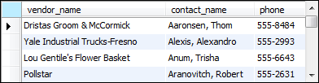

Slide 8
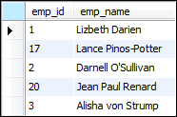

Slide 9
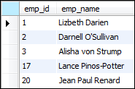

Slide 10


Slide 11
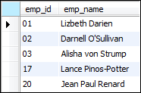

Slide 12
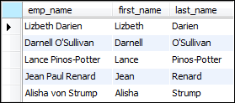

Slide 13
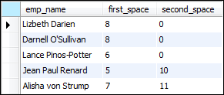

Slide 14
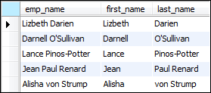

Slide 15
Notes:
TRUNCATE = CUT IT OUT
ROUND = ROUND TO THE NEAREST
ABS = ABSOLUTE
RAND = RANDOM

Slide 17
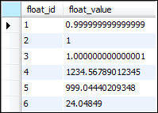


Slide 18



Slide 19
Notes:
Critical
The most common is NOW() or CURRENT_TIMESTAMP()
Used in generating reports as part of records
Transaction occurs

Slide 21
Notes:
Calculate when membership expires
what’s now + year
Increments basically

Slide 25
Notes:
Can pull exact information from the timestamp or whatever

Slide 26
Notes:
Conversion operators

Slide 30
Notes:
WINDOWS vs UNIX time
1970 for Unix
Different origin time
Time stamps always start at the origin time and figure out the date by subtracting and dividing by the total seconds?

Slide 32
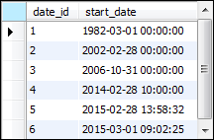


Slide 33


Notes:
Relational operators apply to dates in SQL

Slide 34


Slide 35



Slide 36



Slide 37



Slide 38

Notes:
Multiple choice
When terms_id = 1, do this (and so on)
See the strings come out as in the terms column

Slide 40

Notes:
ELSE in SQL is “DEFAULT” in Java

Slide 41
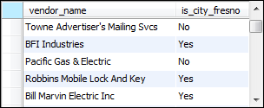
Notes:
If test expression is true, do yes, if not do no

Slide 42

Notes:
If it is NULL, do this (replace NULL with something else)

Slide 43

Notes:
Returns the first non-null value in the list

